Slide 1
SWE2315 : System ANALYSIS & DESIGN
Lecture 02: Planning
At: CIT Theater
By: 2-4pm

Slide 2
Outline
Project selection.
Project Management
Planning Tools

Slide 3
Recap: Project Planning
Project Initiation
Project Management

Slide 4
Recap: Project Initiation
Identification is Done by Project Sponsor
System Request is then written after identification
Feasibility is conducted on the System Request

Slide 5
Project Management
Project Selection
Create the Project Plan
1. Project Methodology (Selection and time frame estimate.
2. Develop the Work Plan
3. Staffing
a. Staff Plan(Motivation and Handling Conflicts)
b. Coordinating Project Activities(Case Tools, Standards, and Documents)
4. Managing and Controlling the Project
a. Refine Estimates
b. Manage Scope
c. Timeboxing
d. Manage Risk

Slide 6
Project Selection
CIOs (chief information officers) are challenged to select projects that will provide highest return on the IT investments.
A selected system development project must undergo a thorough process of project management (such as planning, execution, control, closure).
An approval committee must be selective about where to allocate resources as most organizations have limited funds.

Slide 7
Project Selection
If there are several potentially high-payoff projects, and they all have the same risk, then maybe only one of the projects will be selected.
Once a project is launched by being selected by the approval committee, it is time to carefully plan the project.
The project manager will follow a set of project management guidelines to organize, guides, and directs the project from inception to completion.

Slide 8
Creating the Work Plan
This involves four (4) major activities:
Selecting the appropriate development methodology (SDLC).
Developing the Work Plan
Staffing the Project
Coordinating project activities

Slide 9
1. Selecting SDLC
There are a number of different project methodologies that can be used to structure and guide systems development projects.
Several of the key methodologies are waterfall development, parallel, V-model, rapid application development; including iterative development, system prototyping, and throwaway prototyping; and agile development

Slide 10
Selecting SDLC
The project manager evaluates characteristics of the project, including factors such as :
clarity of user requirements,
familiarity with technology,
complexity,
reliability,
time frame, and schedule visibility, to select the most appropriate methodology to use for the project.

Slide 11
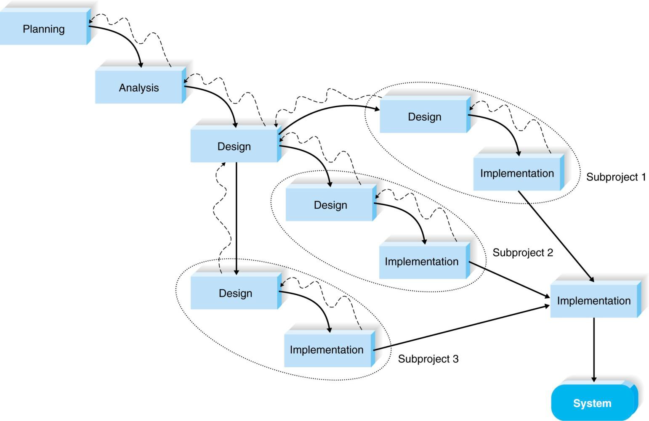
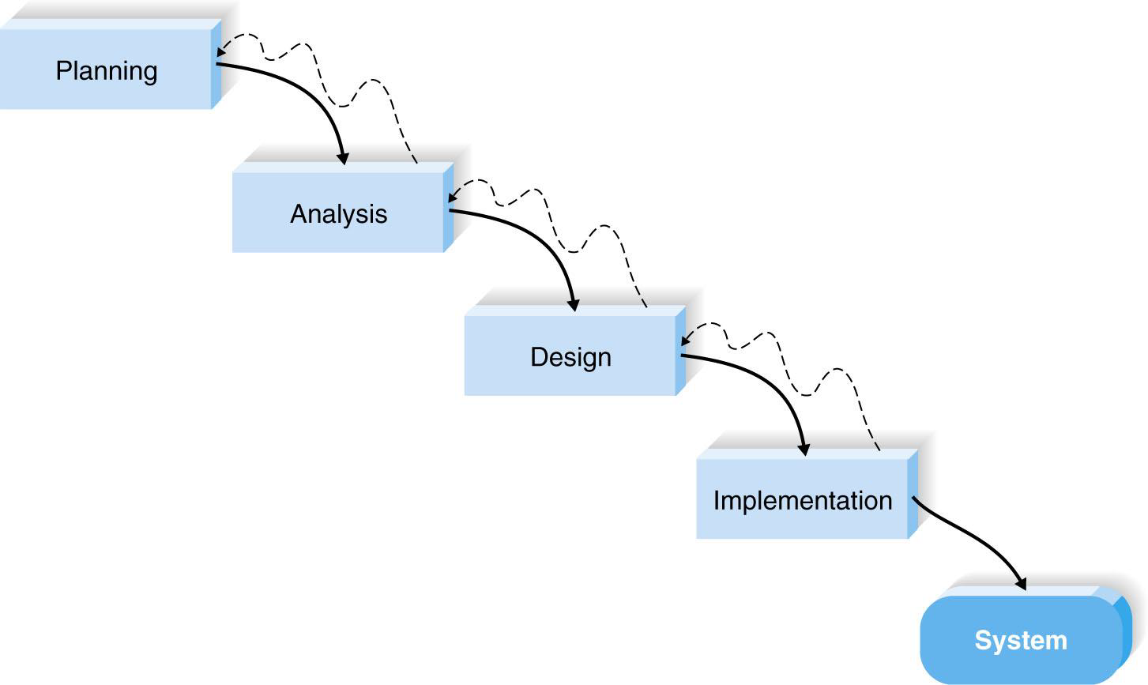
Waterfall & Parallel Development

Slide 12
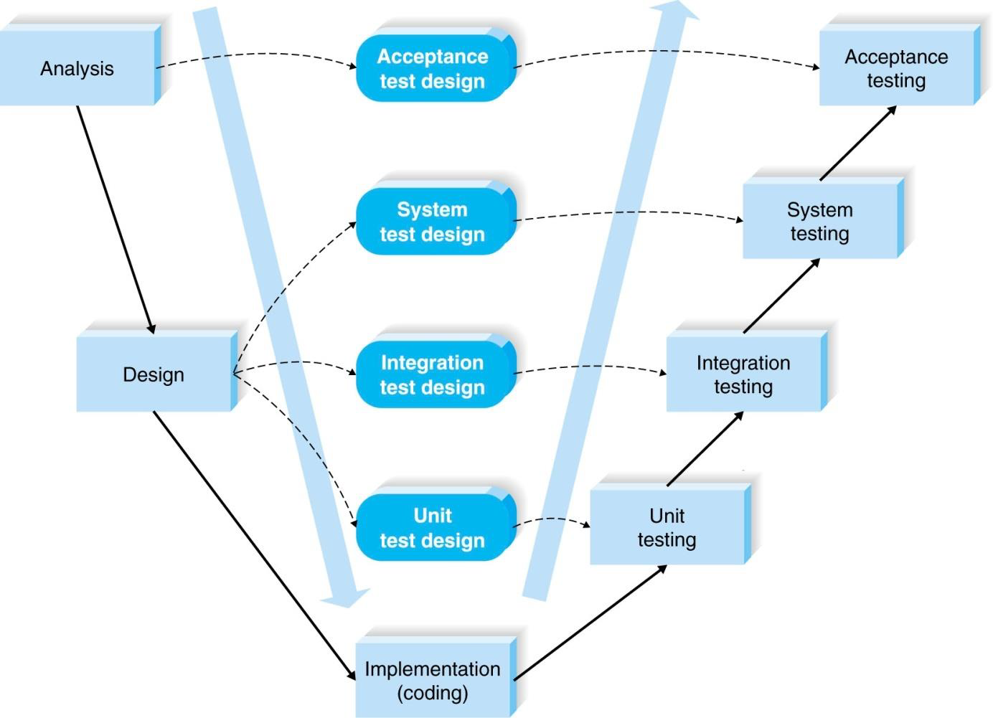
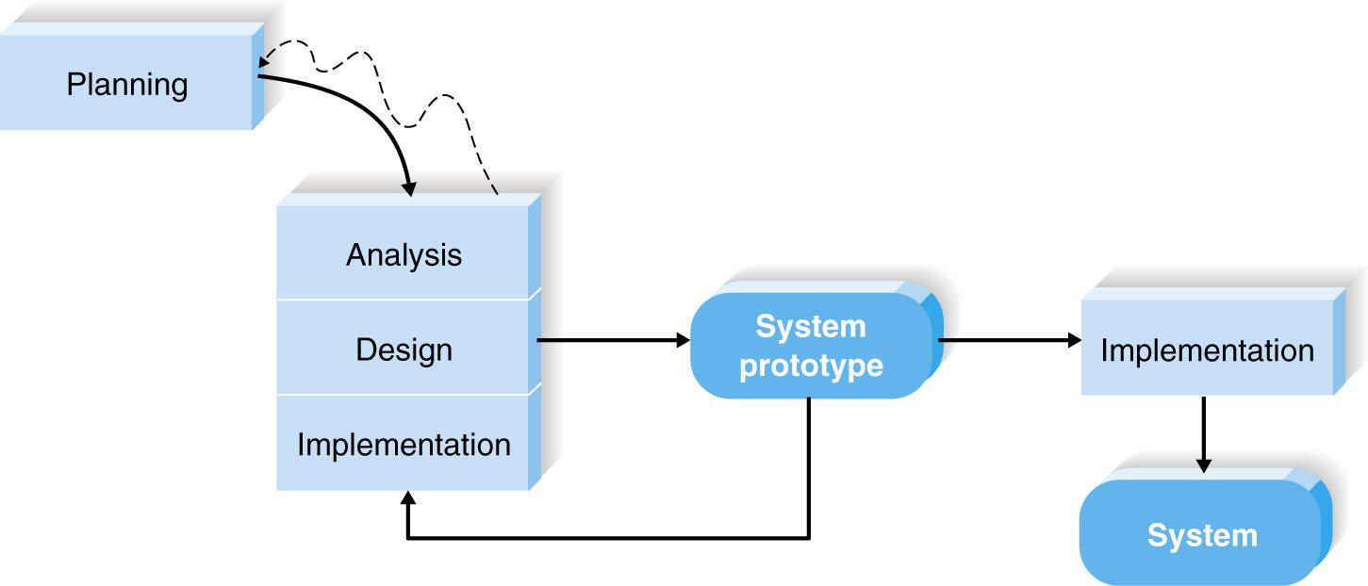
V Model & Prototyping Development

Slide 13
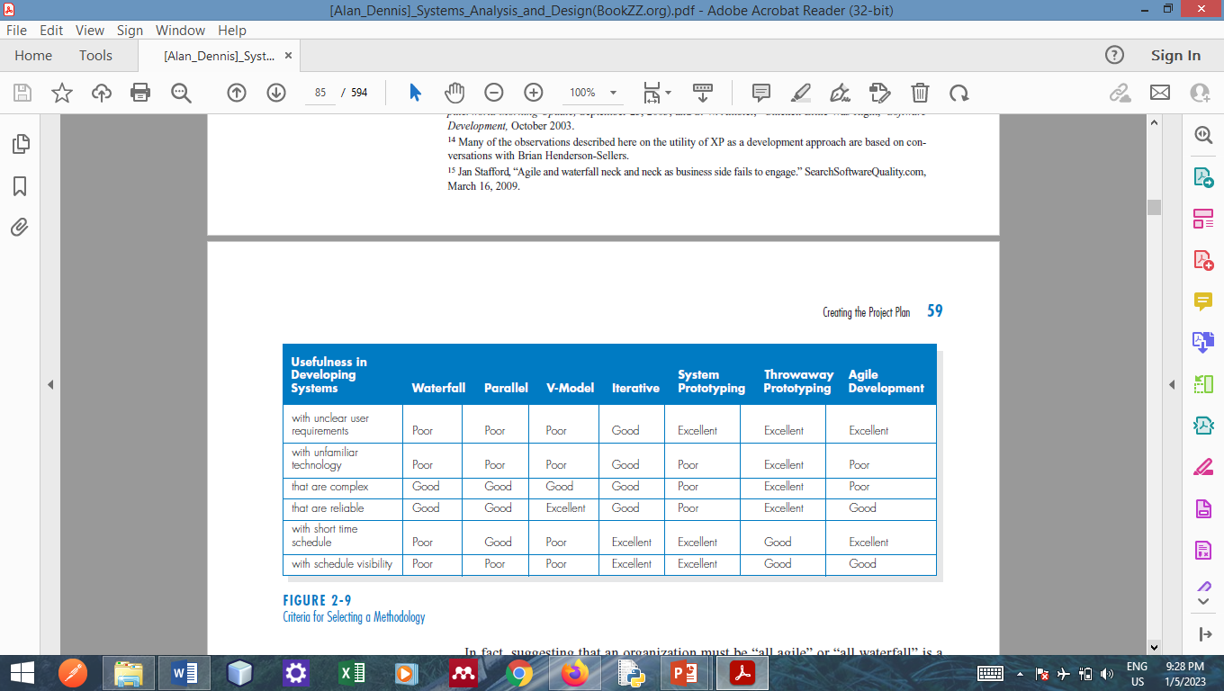
Selecting Criteria SDLC

Slide 14
Estimating Time Frame
The project manager estimates the time frame for the project.
Estimation is the process of assigning projected values for time and effort.
Estimation can be performed manually or with the help of an estimation software.
Past experience and industry standards provide help in this task.
Notes:
Construx Estimate,TM Costar,TM or KnowledgePLAN®

Slide 15
2. Develop work plan
The project methodology provides lists of tasks and deliverables for projects, which the project manager modifies, depending on the needs of the specific project.
To create a work plan, the project manager:
Identify/refines the tasks
Breakdown the tasks into a work breakdown structure,
Estimates task time
Add other information if needed.

Slide 16
Identify Task

Slide 17
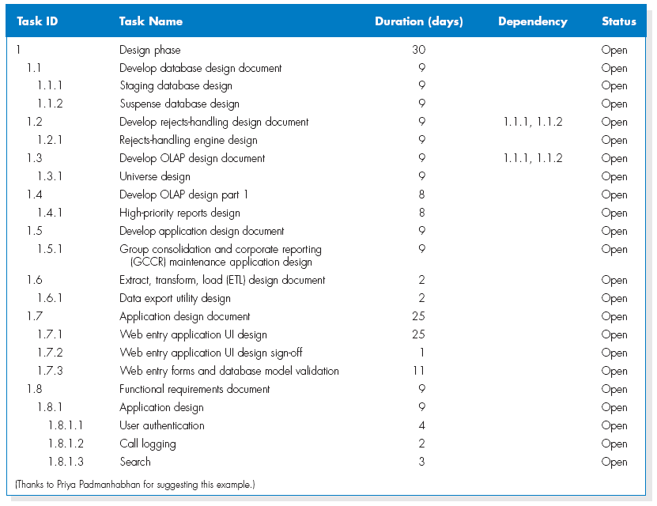
Work Breakdown Structure

Slide 18
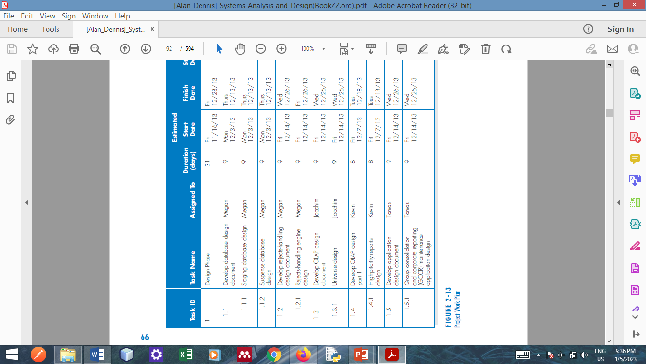
The Project Work Plan

Slide 19
3. Staffing
Staffing involves determining:
how many people should be assigned to the project,
assigning project roles to team members,
developing a reporting structure for the team,
and matching people’s skills with the needs of the project.

Slide 20
Staff plan: Motivation and Handling Conflicts
Staffing also includes:
motivating the team to meet the project’s objectives using monetary rewards cautiously or Use intrinsic rewards such as
–Recognition
–Achievement
–The work itself
–Responsibility
–Advancement
–Chance to learn new skills
minimizing conflict among team members thorough Project charter listing norms and ground rules.

Slide 21
Coordinating Project Activities
Coordinating project activities includes putting efficient development practices in place and mitigating risk, and these activities occur over the course of the entire SDLC.
Three techniques are available to help coordinate activities on a project:
computer-aided software engineering (CASE),
standards,
documentation.
Notes:
CASE is a category of software that automates all or part of the development
process;

Slide 22
CASE, Standards, Documents
CASE (computer-aided software engineering) tools –A category of software that automate all or part of the development process.
Standards
–Formal rules for naming files
–Forms indicating goals reached
–Programming guidelines
Documentation
–Project binder
–Table of contents
–Continual updating
©
Notes:
CASE is a category of software that automates all or part of the development
process;

Slide 23
4. Managing and Controlling Projects
The science (or art) of project management is in making trade-offs among three important concepts:
-the size of the system,
-the time to complete the project, and
-the cost of the project.
Think of these three things as interdependent levers that the project manager controls throughout the SDLC.

Slide 24
Managing and Controlling Projects
Whenever one lever is pulled, the other two levers are affected in some way.
For example, if a project manager needs to readjust a deadline to an earlier date, then the only solution is to decrease the size of the system (by eliminating some of its functions) or to increase costs by adding more people or having team members work overtime.
Often, a project manager will have to work with the project sponsor to change the goals of the project, such as developing a system with less functionality or extending the deadline for the final system, so that the project has reasonable goals that can be met.

Slide 25
Project Planning Tools
Project managers utilize several tools to help manage projects.
The project work plan is a critical element of managing projects.
Two graphical tools are widely used :
Gantt chart and
PERT

Slide 26
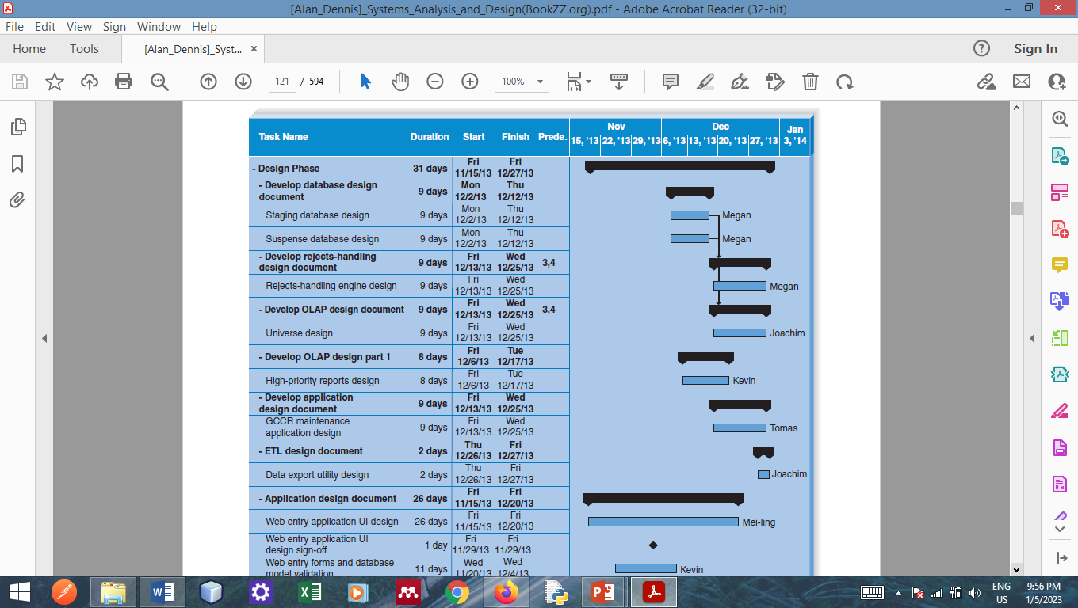
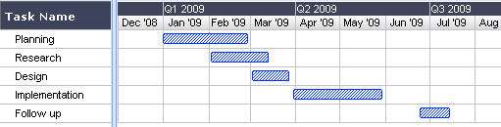
Gantt Chart

Slide 27
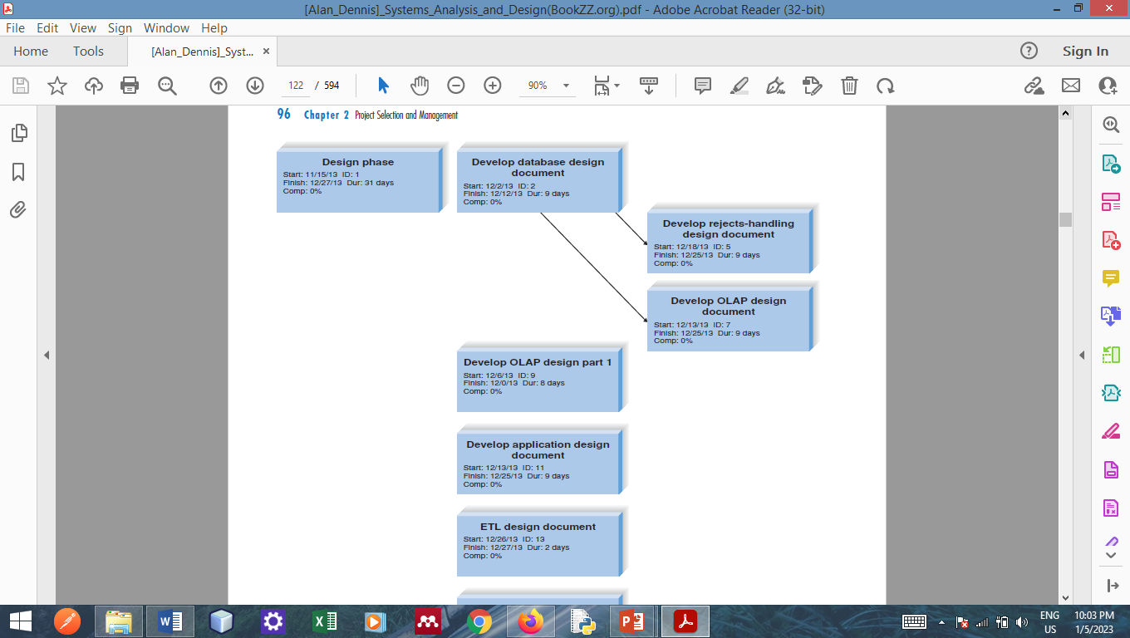
PERT Chart

Slide 28
Summary
The project selection process takes into account all of the projects in the organization, using project portfolio management.
The project plan defines the tasks, task time estimates, and other information.
A project requires staffing and coordinating project activities.

Slide 29
Questions !!!

